Slide 1
Software Process Models
Zeeshan Ali Rana

Slide 2
Recap
Software Engineering (SE)
Costs in Software Engineering
Software vs Hardware (How is software different?)
Need of SE
Software lifecycle
Software Quality

Slide 3
Process
Is a series of steps involving activities, constraints, and resources to produce an intended output
Prepare for exams
Conduct a software competition
Organize a trip
Write a term project report
Involves a set of tools and techniques
Block diagrams
Notations

Slide 4
Is a process Useful?
Impose consistency and structure on a set of activities
Guide us to understand, control, examine, and improve the activities
Enable us to capture our experiences and pass them along

Slide 5
Framework Activities
Communication
customer, other stakeholders
Planning
Roadmap, project plan
Modeling
Understanding requirements, provide design
Construction
Code generation, testing
Deployment
Delivery to customer, feedback and evaluation

Slide 6
Software Engineering Practice
Understand the problem
Plan a solution
Carry out the plan
Examine the results for accuracy

Slide 7
Software Engineering Practice
Understand the problem (communication, analysis)
Plan a solution (modeling and design)
Carry out the plan (code generation)
Examine the results for accuracy (testing and QA)

Slide 8
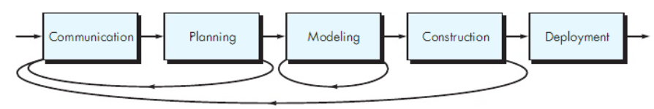
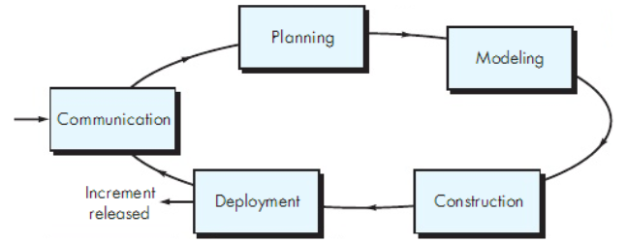
Process Flow

Slide 9
Software Lifecycle
When a process involves building a software (product), the process may be referred to as software (product) lifecycle
Requirements analysis and definition
System (architecture) design
Program (detailed/procedural) design
Writing programs (coding/implementation)
Testing: unit, integration, system
System delivery (deployment)
Maintenance

Slide 10
Umbrella Activities
Quality Assurance
Configuration Management
Technical Reviews
Project Tracking and Control
Risk Management
TR
CM
PTC
SE Process
RM
QA

Slide 11
What is a Process Model?
Description of a process, evolved overtime, in a certain format
May use text, pictures, or a combination
Contains key process features

Slide 12
Why is a Process Model Needed?
To form a common understanding
To find inconsistencies, redundancies, omissions
To find and evaluate appropriate activities for reaching process goals
To tailor a general process for a particular situation in which it will be used

Slide 13
Nature of Software Process Model?
Models that prescribe how should development of software progress
Models that describe how is software developed in actuality

Slide 14
Software Development Process Models
Waterfall model
Classical
With prototyping
V model
Prototyping model
Phased development: increments and iterations
Spiral model
Unified process
Rapid Application Development (RAD)
Agile methods
XP
Scrum
Kanban

Slide 15
Waterfall Model
One of the first process development models proposed
Works for well understood problems with minimal or no changes in the requirements
Simple and easy to explain to customers
It presents
a very high-level view of the development process
sequence of process activities
Each major phase is marked by milestones and deliverables (artefacts)

Slide 16
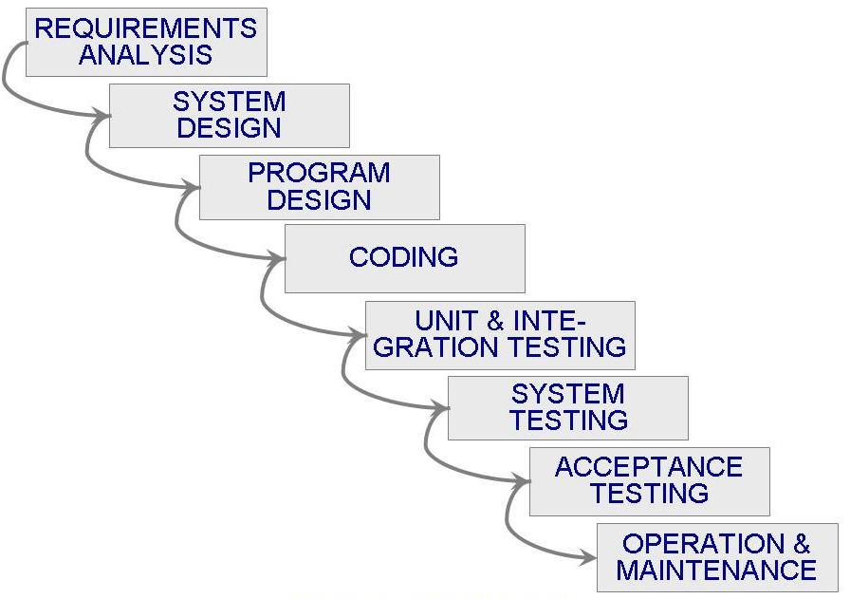
Waterfall Model (Contd.)

Slide 17
Waterfall Model (Contd.)
Provides no guidance how to handle changes to products and activities during development (assumes requirements can be frozen)
Views software development as manufacturing process rather than as building process
There are no iterative activities that lead to building a final product
Long wait before a final product
Generates lots of documentation
Considered suitable for large projects

Slide 18
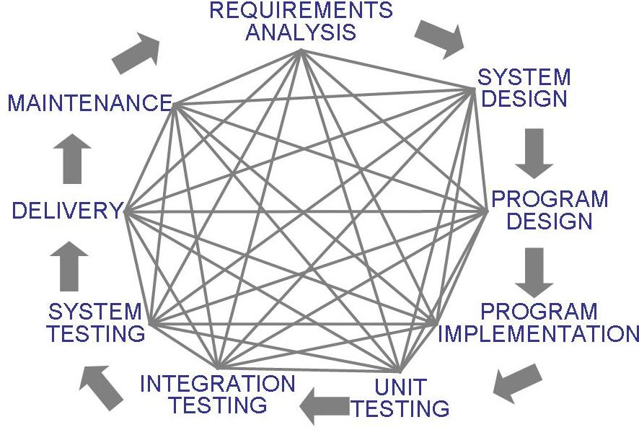
Waterfall Model (Contd.)
Uncontrolled Software Development Process
No Iterations in WF?
Loop: Problem Definition, Technical Design and Development, Integration, Operations and Maintenance
Notes:
Loop: Problem Definition, Technical Design and Development, Integration, Operations and Maintenance

Slide 19
Waterfall Model with Prototyping
A prototype is a partially developed product
Prototyping helps
developers assess alternative design strategies (design prototype)
users understand what the system will be like (user interface prototype)

Slide 20
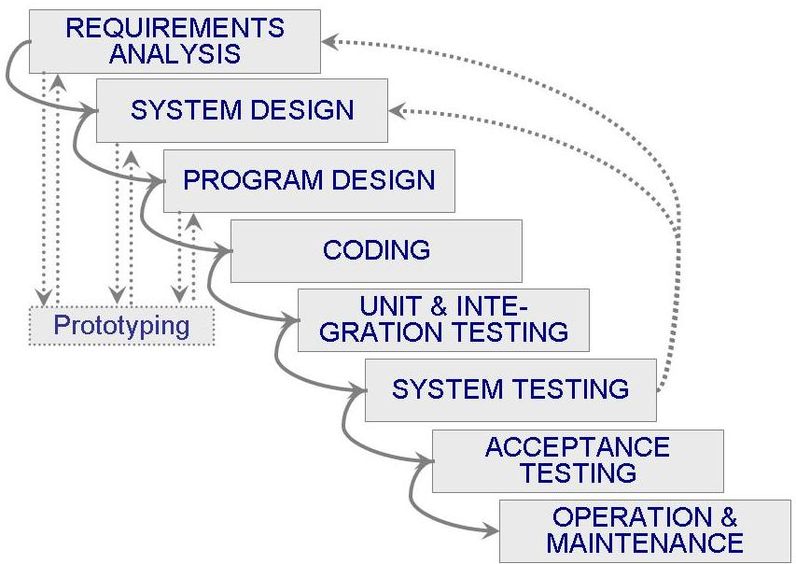
Waterfall Model with Prototyping

Slide 21
V Model
A variant of the waterfall model
Uses unit testing to verify procedural design
Uses integration testing to verify architectural (system) design
Uses acceptance testing to validate the requirements
If problems are found during verification and validation, the left side of the V can be re-executed before testing on the right side is re-enacted
Verification: Each function works correctly
Validation: All requirements have been implemented and each functionality can be traced back to a particular requirement

Slide 22
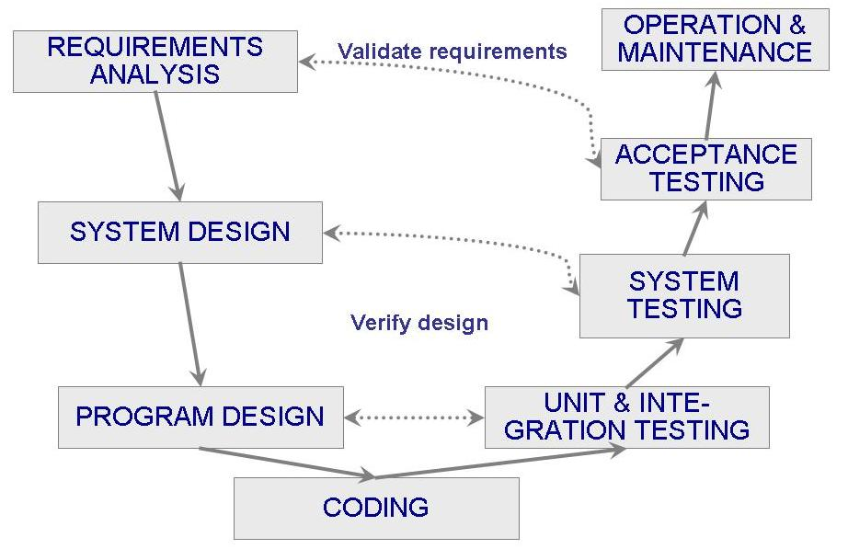
V Model (Contd.)

Slide 23
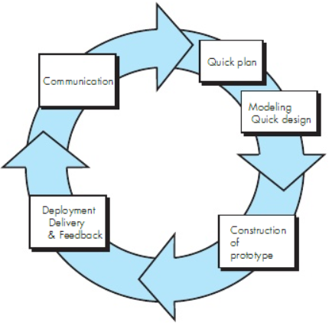
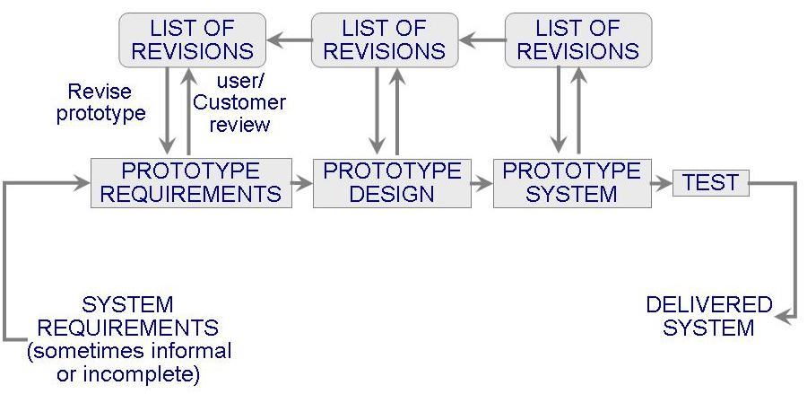
Prototyping Model
Allows repeated investigation of the requirements or design
Reduces risk and uncertainty in the development

Slide 24
Prototyping Model (Contd.)
Features
User involvement?
Smaller projects?

Slide 25
References
SE, Pressman
SE, Pfleeger
Acknowledgement
A few slides have been adapted from UCF slides for the SE course

